Slide 1
3D Bridge Design
Azmary Akter 193902019

Slide 2
Introduction:
Bridge design can be done with Autocad Civil 3D or Autodesk Infraworks but both packages have no tools for analysis and detailing of tendons and rebars. Bridge geometry can be imported into Revit from Infraworks and can be used to create a rebar model with tendons and to produce required deliveries like 2D drawings, schedules and data for production.

Slide 3
Tools:
liNE Command.
ARC Command.
Press Pull.
Swap.
Union.
3d Rotated.
Trim.
Erase.
Copy.
Move.

Slide 4
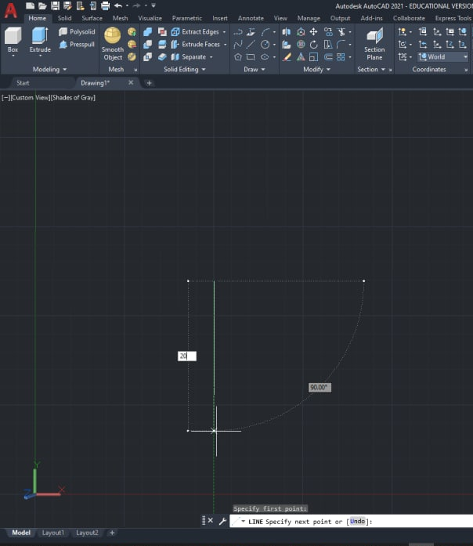
Line Command:

Slide 5
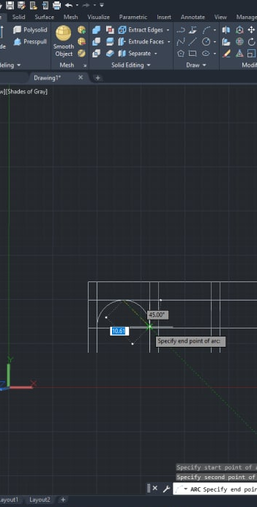
ARC Command:

Slide 6
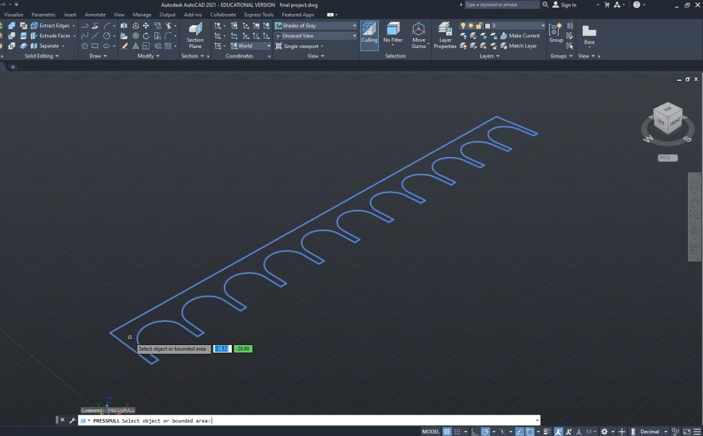
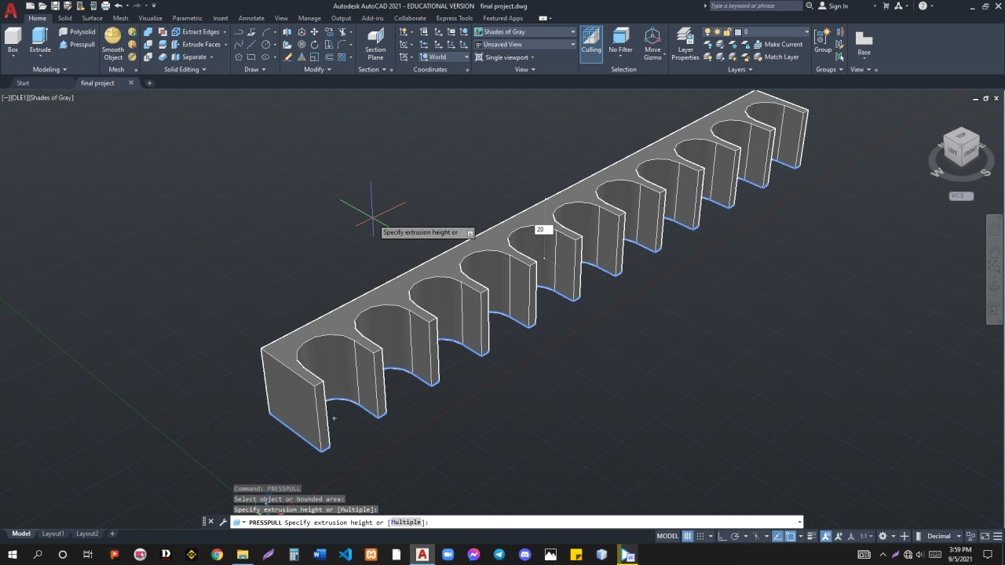
PressPull Command:

Slide 7
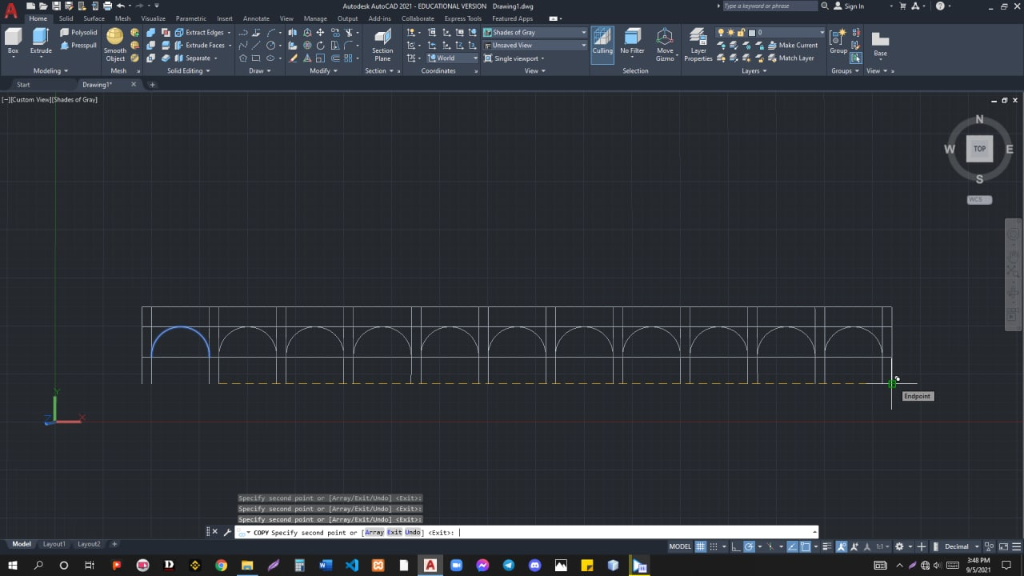
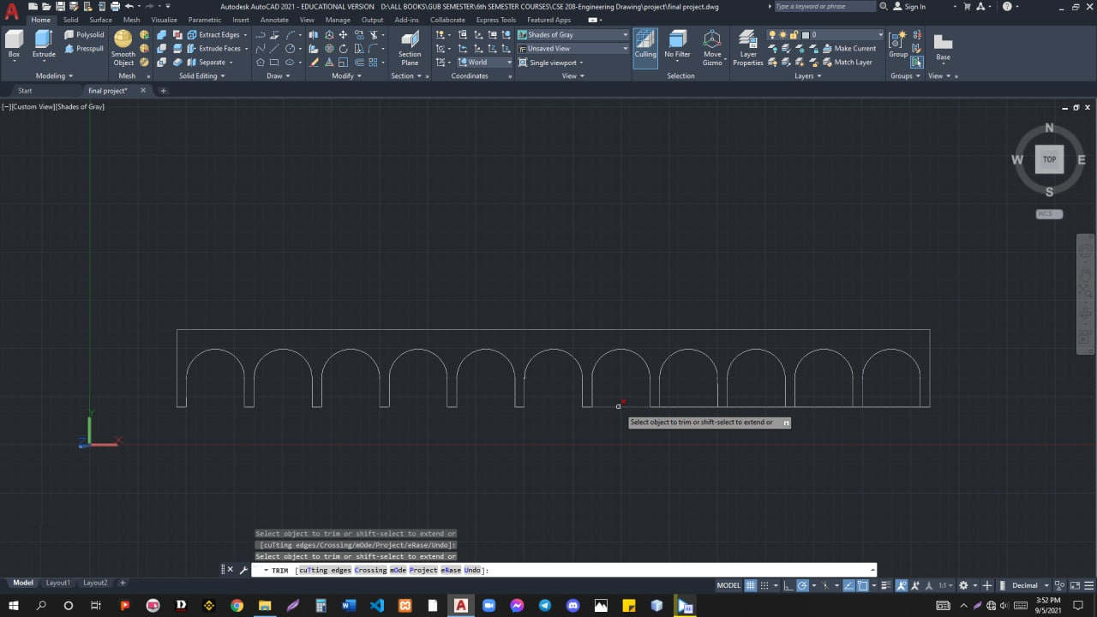
Trim Command:

Slide 8
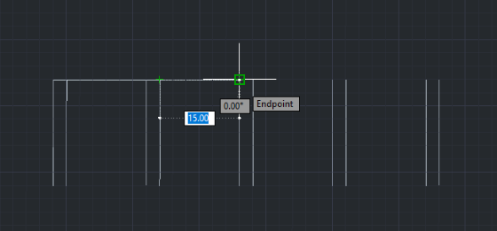
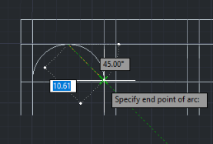
Implement:
Line command:
ARC command:

Slide 9
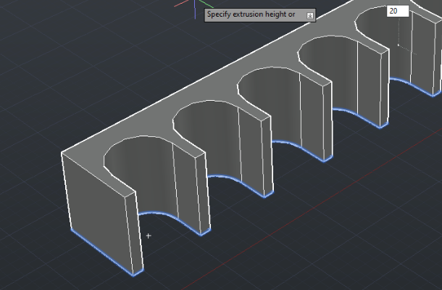
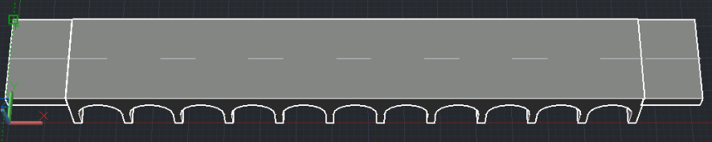
Implement:
PressPull command:
3d Rotate Command:

Slide 10
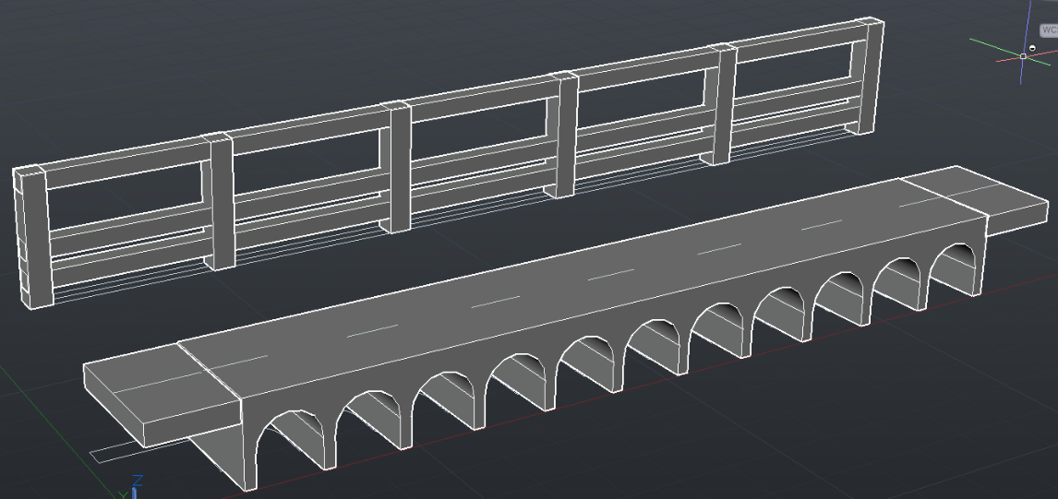
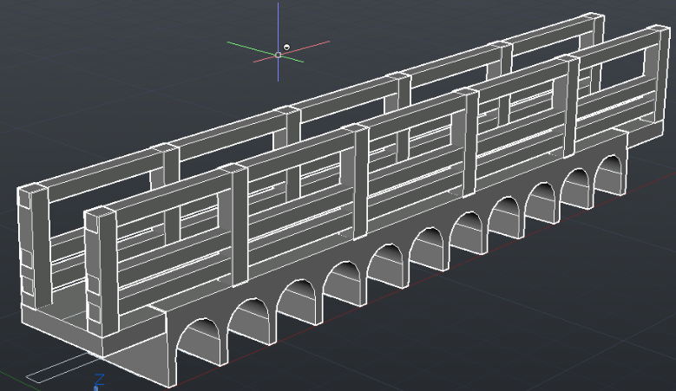
Implement:
Swap command:
Insert railing:

Slide 11
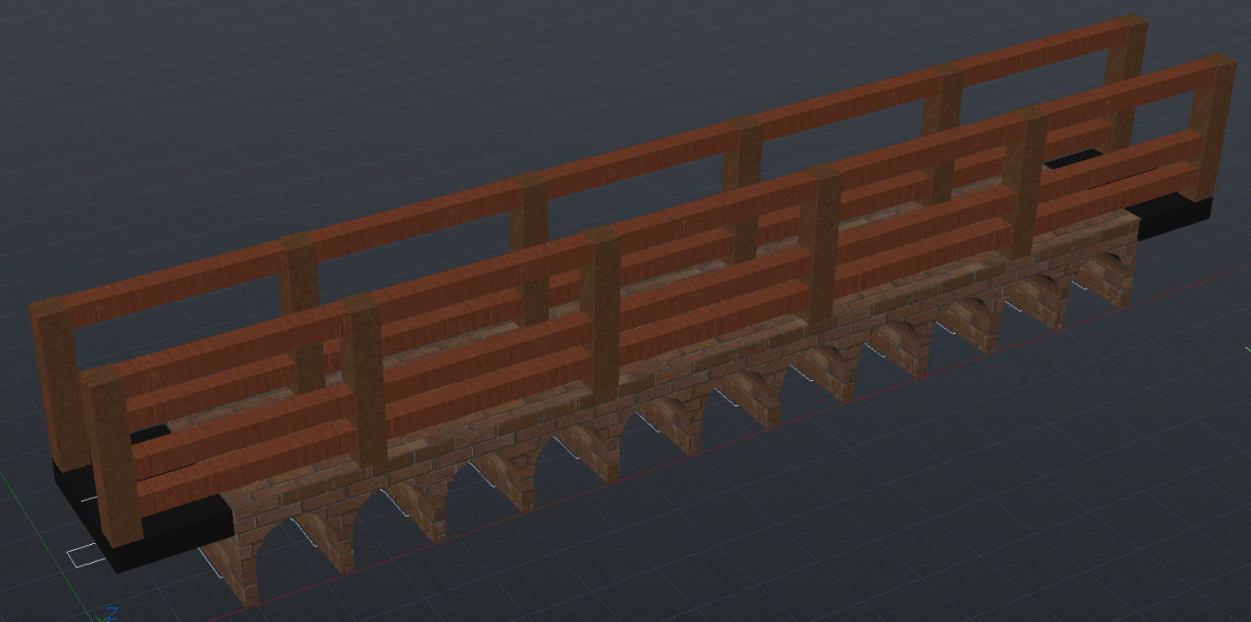
Final result:

Slide 12
Thank You!!

